Slide 1
Logistic Regression
Statistical Data Analysis, 2023

Slide 2

P(tiger = Yes) = f(a + b*no_of_legs + c*skin_color + d*stripe + ...)

Slide 3
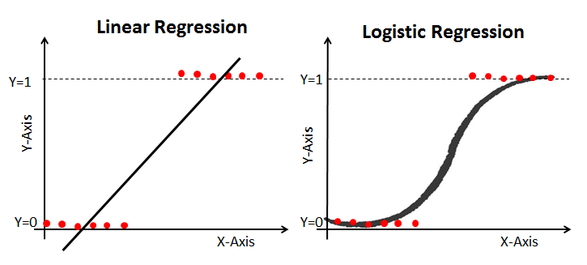
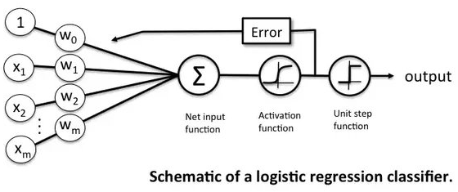

Logistic Regression
What is it about (mostly)
Activation function: $sigmoid\left(z\right)=\frac{1}{1+e^{−z}}$
As a (deterministic) classifier for prediction.
In fact, it is much more than that as a statistical model, which allows to
describe the noisy data (association, etc)
perform statistical inference
Notes:
As a classifier, the logistic transfer function is used as a tool to smoothen the hard threshold function
(mainly for the purpose of doing back-propagation).
In this sense, the logistic regression is rather deterministic.

Slide 4
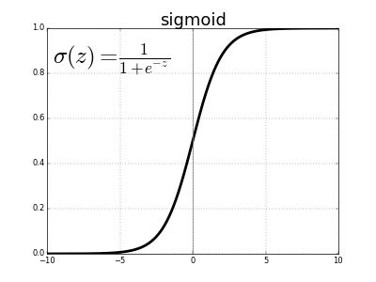
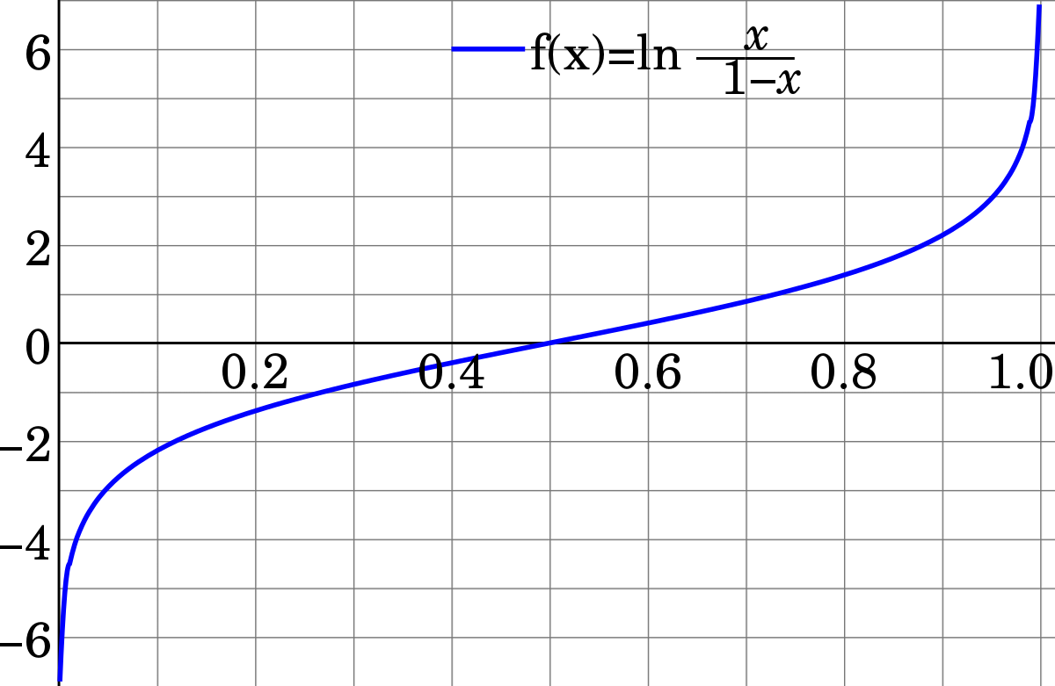
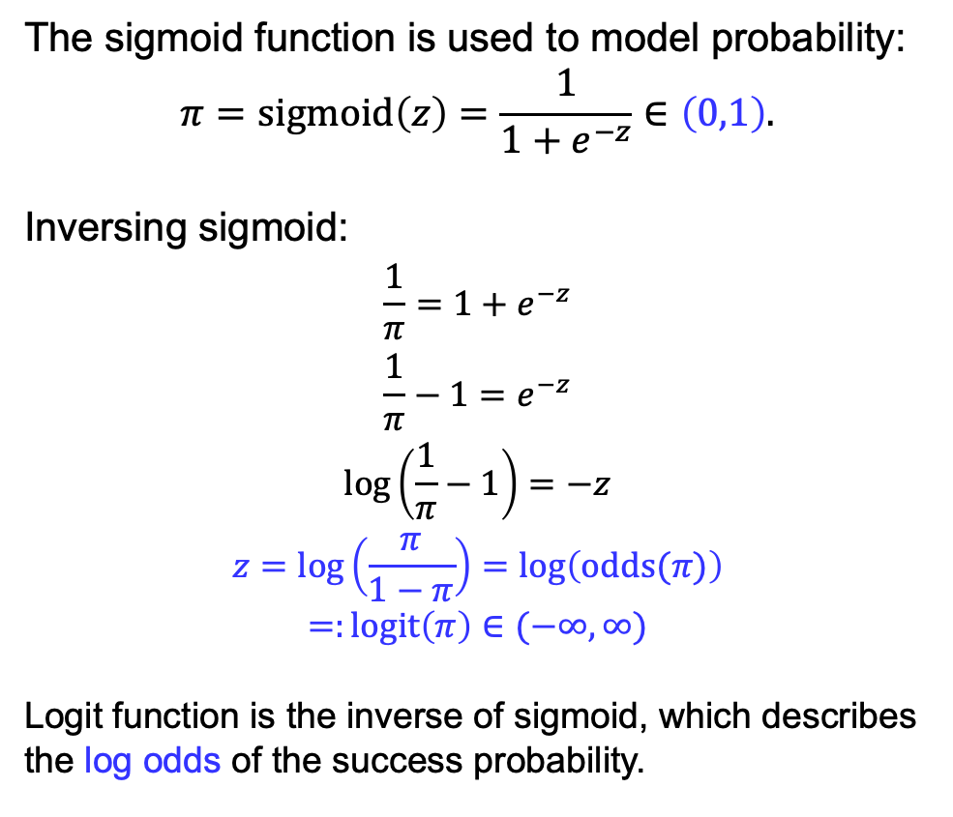
Sigmoid and Logit
The sigmoid function is used to model probability:
$$π=sigmoid\left(z\right)=\frac{1}{1+e^{−z}}∈\left(0,1\right).$$
Inversing sigmoid:
$$\frac{1}{π}=1+e^{−z}$$
$$\frac{1}{π}−1=e^{−z}$$
$$\log\left(\frac{1}{π}−1\right)=−z$$
$$z=\log\left(\frac{π}{1−π}\right)=\log\left(odds(π)\right)$$
$$=:logit\left(π\right)∈(−∞,∞)$$
Logit function is the inverse of sigmoid, which describes the log odds of the success probability.

Slide 5
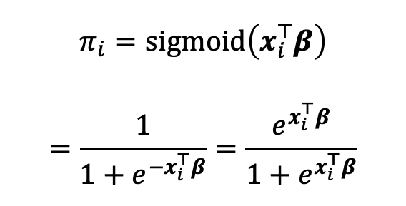
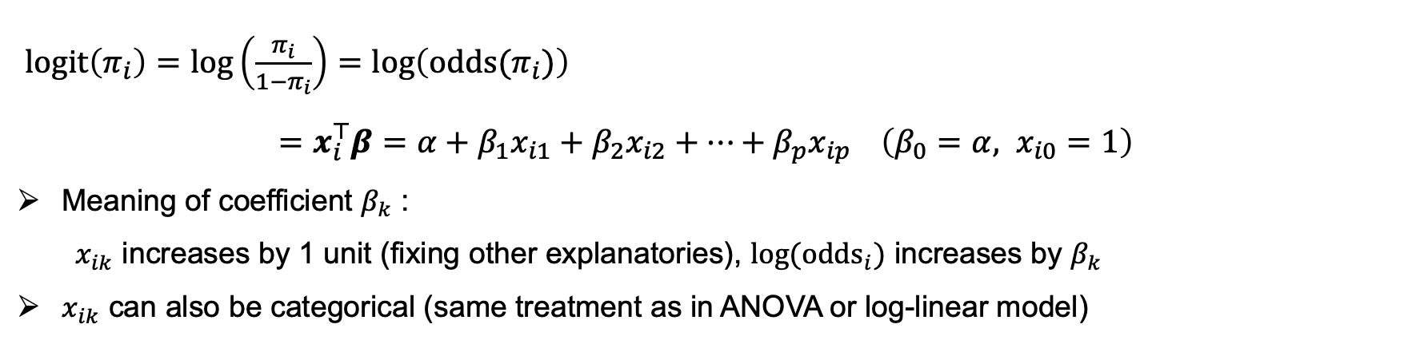
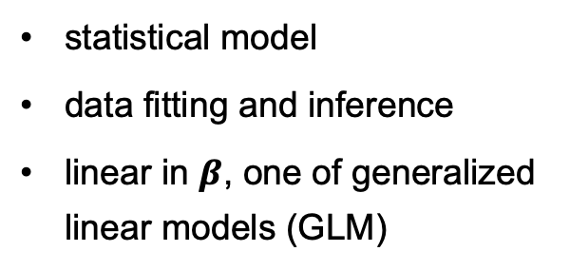
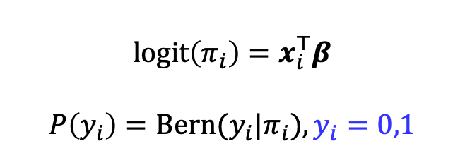
Logistic Regression — Statistical model
$$π_{i}=sigmoid\left(x_{i}^{⊤}β\right)$$
$$=\frac{1}{1+e^{−x_{i}^{⊤}β}}=\frac{e^{x_{i}^{⊤}β}}{1+e^{x_{i}^{⊤}β}}$$
$$\operatorname{logit}\left(π_{i}\right)=x_{i}^{⊤}β$$
$$P\left(y_{i}\right)=Bern(y_{i}|π_{i}),y_{i}=0,1$$
statistical model
data fitting and inference
linear in $β$, one of generalized linear models (GLM)
$\operatorname{logit}\left(π_{i}\right)=log\left(\frac{π_{i}}{1−π_{i}}\right)=\log\left(odds(π_{i})\right)$
$=x_{i}^{⊤}β=α+β_{1}x_{i1}+β_{2}x_{i2}+…+β_{p}x_{ip} \left(β_{0}=α, x_{i0}=1\right)$
Meaning of coefficient $β_{k}$ :
$x_{ik}$ increases by 1 unit (fixing other explanatories), $\log{({odds}_{i})}$ increases by $β_{k}$
$x_{ik}$ can also be categorical (same treatment as in ANOVA or log-linear model)

Slide 6
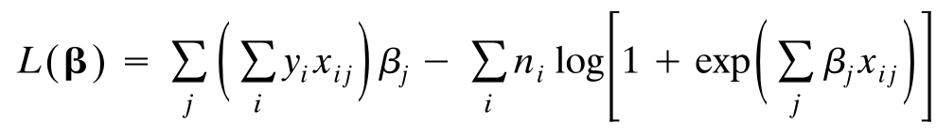
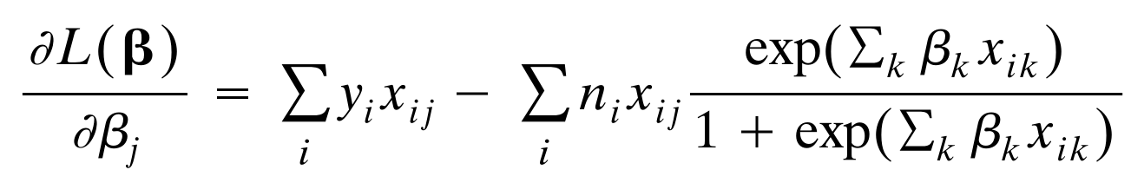
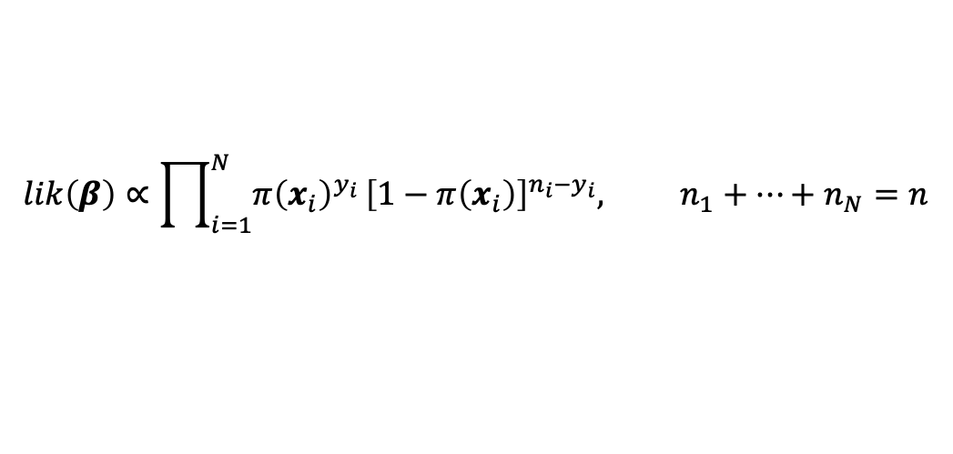

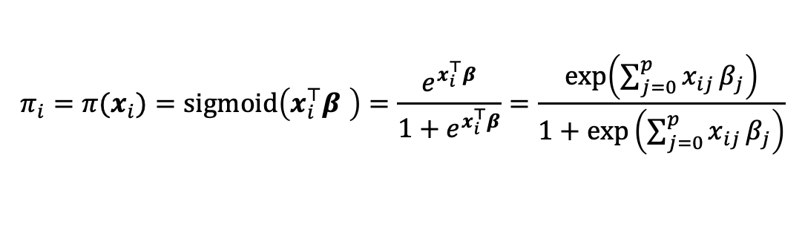
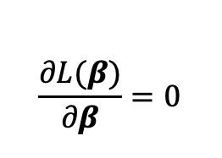
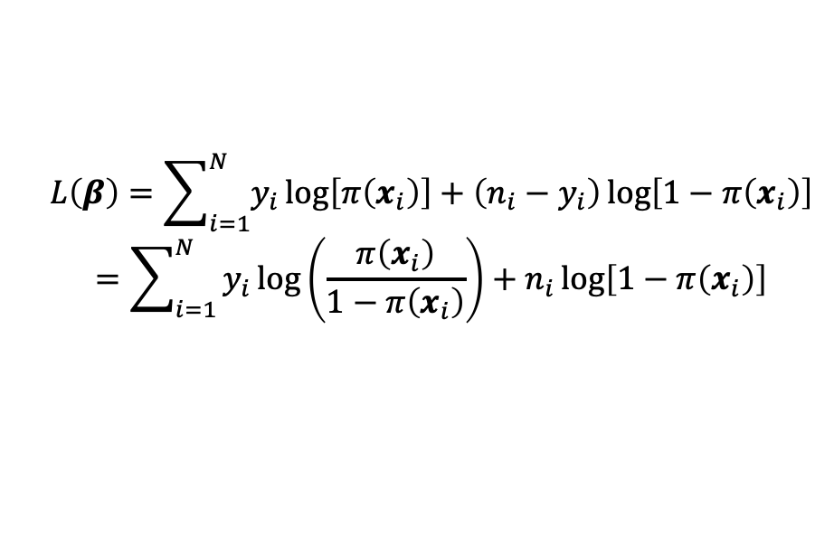
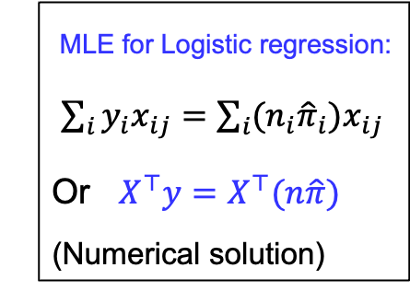
Logistic Regression — Fitting by Maximum Likelihood (Optional)
Suppose at each $x_{i}$ value, one records $n_{i}$ observations and $y_{i}$ successes:
$$lik\left(β\right)∝\prod_{i=1}^{N}{π{\left(x_{i}\right)}^{y_{i}}}{\left[1−π\left(x_{i}\right)\right]}^{n_{i}−y_{i}}, n_{1}+…+n_{N}=n$$
$$π_{i}=π(x_{i})=sigmoid\left(x_{i}^{⊤}β \right)=\frac{e^{x_{i}^{⊤}β}}{1+e^{x_{i}^{⊤}β}}=\frac{\exp\left(\sum_{j=0}^{p}{x_{ij}}β_{j}\right)}{1+\exp\left(\sum_{j=0}^{p}{x_{ij}}β_{j}\right)}$$
$$L\left(β\right)=\sum_{i=1}^{N}{y_{i}\log\left[π\left(x_{i}\right)\right]+\left(n_{i}−y_{i}\right)\log\left[1−π\left(x_{i}\right)\right]}$$
$$=\sum_{i=1}^{N}{y_{i}\log\left(\frac{π\left(x_{i}\right)}{1−π\left(x_{i}\right)}\right)+n_{i}\log\left[1−π\left(x_{i}\right)\right]}$$
$$logit\left(sigmoid\left(z\right)\right)=z$$
MLE for Logistic regression:
$\sum_{i}{y_{i}x_{ij}}=\sum_{i}{(n_{i}{\hat{π}}_{i})x_{ij}}$
Or $X^{⊤}y=X^{⊤}(n\hat{π})$
(Numerical solution)
$$\frac{∂L(β)}{∂β}=0$$
Notes:
Need to solve a nonlinear equation to obtain the MLE.

Slide 7
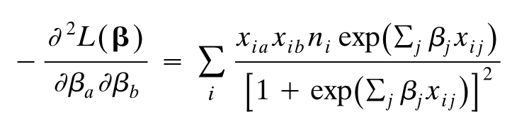
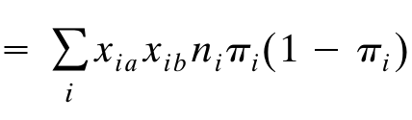
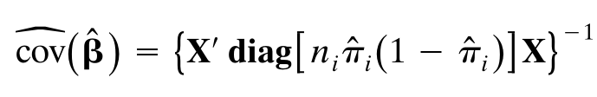

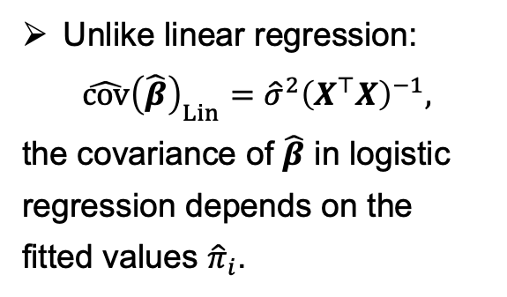
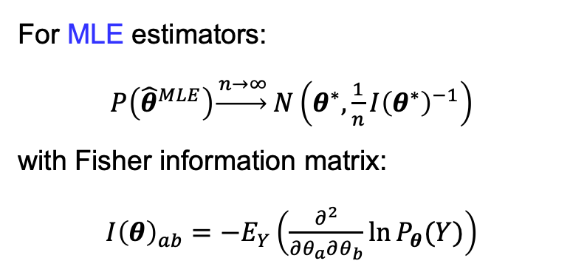
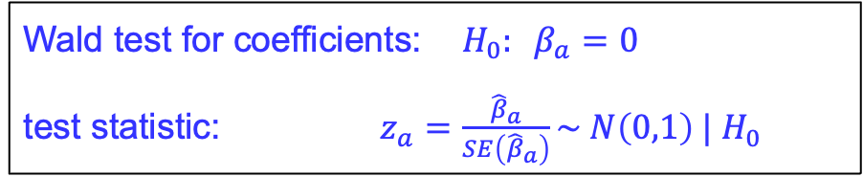
Logistic Regression — Wald test for coefficients (Optional)
Need the Hessian of log-likelihood for parameter inference:
For MLE estimators:
$P\left({\hat{θ}}^{MLE}\right)\underset{→}{ n→∞} N\left(θ^{∗}, \frac{1}{n}I{\left(θ^{∗}\right)}^{−1}\right)$
with Fisher information matrix:
$I{\left(θ\right)}_{ab}=−E_{Y}\left(\frac{∂^{2}}{∂θ_{a}∂θ_{b}}\ln{P_{θ}(Y)}\right)$
Unlike linear regression:
$$\hat{cov}{\left(\hat{β}\right)}_{Lin}={\hat{σ}}^{2}{\left(X^{⊤}X\right)}^{−1},$$
the covariance of $\hat{β}$ in logistic regression depends on the fitted values ${\hat{π}}_{i}$.
Wald test for coefficients: $H_{0}: β_{a}=0$
test statistic: $z_{a}=\frac{{\hat{β}}_{a}}{SE\left({\hat{β}}_{a}\right)}\sim N\left(0,1\right) | H_{0}$
Notes:
When the null hypothesis is true, z_j has a standard normal N(0,1) distribution, providing p-values for significance tests.

Slide 8
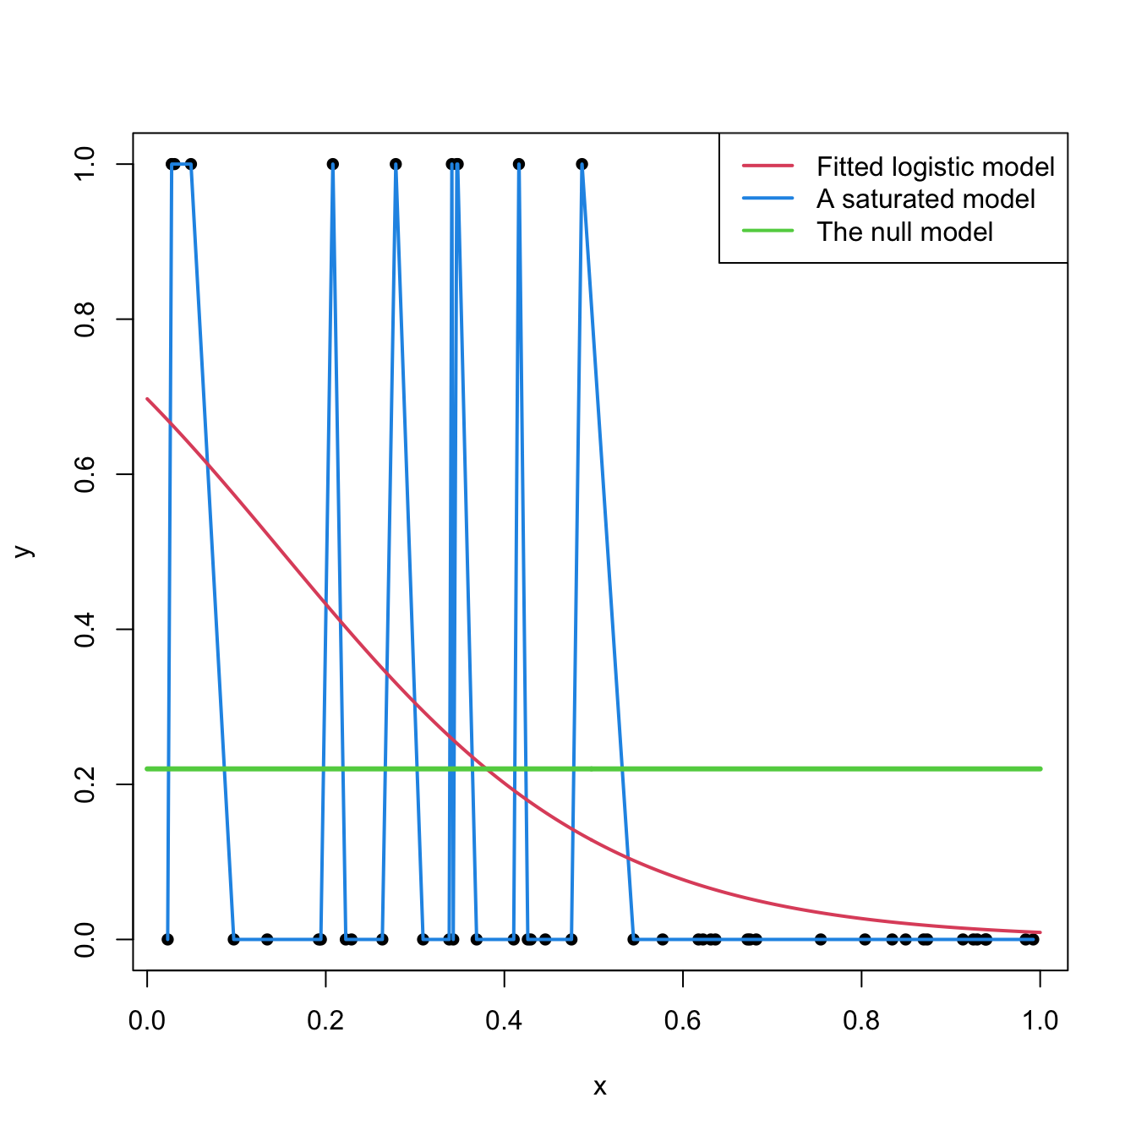
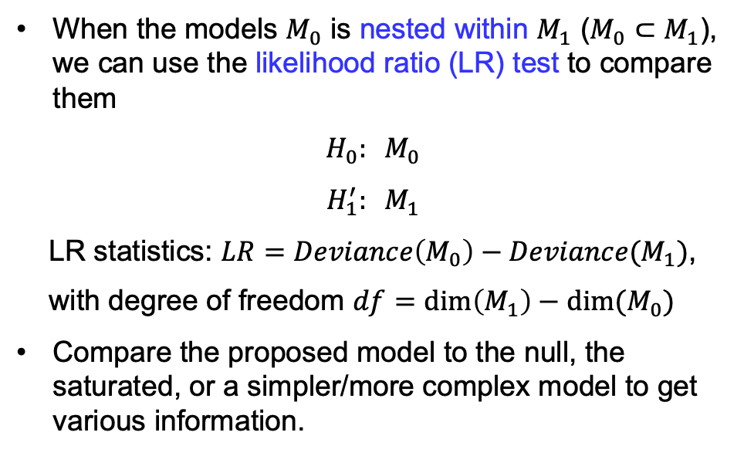
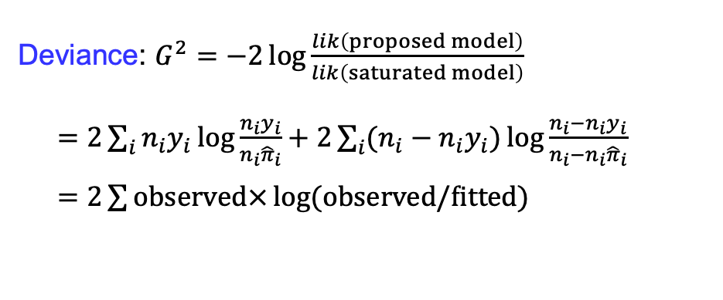
Logistic Regression — Goodness/lack-of-fit by LR test
Deviance: $G^{2}=−2\log{\frac{lik\left(proposed model\right)}{lik\left(saturated model\right)}}$
$=2\sum_{i}{n_{i}y_{i}\log{\frac{n_{i}y_{i}}{n_{i}{\hat{π}}_{i}}}}+2\sum_{i}{(n_{i}−n_{i}y_{i})\log{\frac{n_{i}−n_{i}y_{i}}{n_{i}−n_{i}{\hat{π}}_{i}}}}$
$=2\sum{observed×\log{(observed/fitted)}}$
Intercept-only model
When the models $M_{0}$ is nested within $M_{1}$ ($M_{0}⊂M_{1}$), we can use the likelihood ratio (LR) test to compare them
$$H_{0}: M_{0}$$
$$H_{1}^{′}: M_{1}$$
LR statistics: $LR=Deviance\left(M_{0}\right)−Deviance(M_{1})$,
with degree of freedom $df=dim\left(M_{1}\right)−dim(M_{0})$
Compare the proposed model to the null, the saturated, or a simpler/more complex model to get various information.
Notes:
Less accurate when there is small fitted values.
(This problem does not show up in log-linear model when the number in each cell is not small).

Slide 9
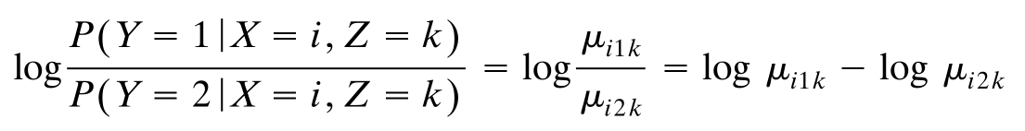
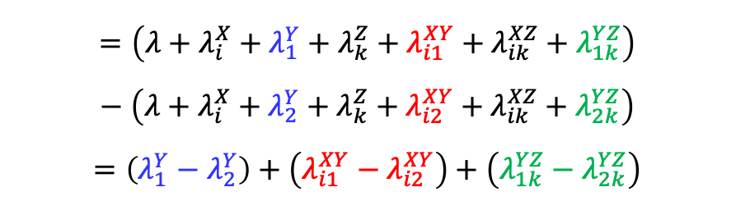
Log-linear – Logit connection
Some log-linear models have a logit model equivalence.
For example, consider the model of homogeneous association:
Z
X
Y
log-linear model of homogeneous association
Suppose Y is the binary response variable, treat X and Z as explanatory, and consider
Z
X
Y
Equivalent logit model
$$=\left(λ+λ_{i}^{X}+λ_{1}^{Y}+λ_{k}^{Z}+λ_{i1}^{XY}+λ_{ik}^{XZ}+λ_{1k}^{YZ}\right)−\left(λ+λ_{i}^{X}+λ_{2}^{Y}+λ_{k}^{Z}+λ_{i2}^{XY}+λ_{ik}^{XZ}+λ_{2k}^{YZ}\right)$$
$$=\left(λ_{1}^{Y}−λ_{2}^{Y}\right)+\left(λ_{i1}^{XY}−λ_{i2}^{XY}\right)+\left(λ_{1k}^{YZ}−λ_{2k}^{YZ}\right)$$
A logit model with an additive form:
Notes:
Let: Y = 1: success, Y = 2: failed,
Odds = P(Y=1) / P(Y=2)

Slide 10
Log-linear – Logit connection
As another example, consider the model of conditional independence (a special case of homogeneous association):
Z
X
Y
log-linear model of conditional independence
Suppose Y is the binary response variable, treat X and Z as explanatory, and consider
Z
X
Y
Equivalent logit model
$$=\left(λ+λ_{i}^{X}+λ_{1}^{Y}+λ_{k}^{Z}+λ_{i1}^{XY}+λ_{ik}^{XZ}+λ_{1k}^{YZ}\right)−\left(λ+λ_{i}^{X}+λ_{2}^{Y}+λ_{k}^{Z}+λ_{i2}^{XY}+λ_{ik}^{XZ}+λ_{2k}^{YZ}\right)$$
$$=\left(λ_{1}^{Y}−λ_{2}^{Y}\right)+\left(λ_{i1}^{XY}−λ_{i2}^{XY}\right)+\left(λ_{1k}^{YZ}−λ_{2k}^{YZ}\right)$$
A logit model with an additive form:
Notes:
Let: Y = 1: success, Y = 2: failed,
Odds = P(Y=1) / P(Y=2)

Slide 11
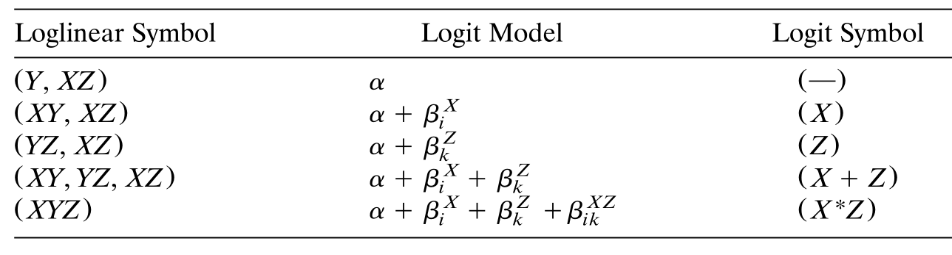
Log-linear – Logit connection
Equivalent Loglinear and Logit Models for a Three-Way Table with Binary Response Variable Y
Note the (XZ) interaction always appears.
Log-linear models are more general for modeling contingency tables.
The logit model has fewer parameters than the log-linear counterpart, therefore it is easier to interpret.
We can use logit models to interpret (some) log-linear models.
Notes:
No restriction on X and Z, therefore they are “saturated” (hardly independent).

Slide 12
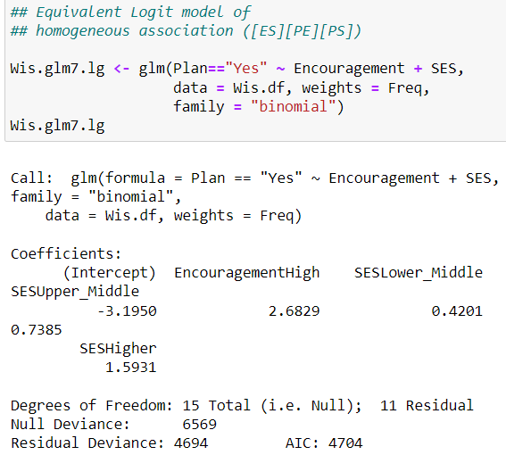
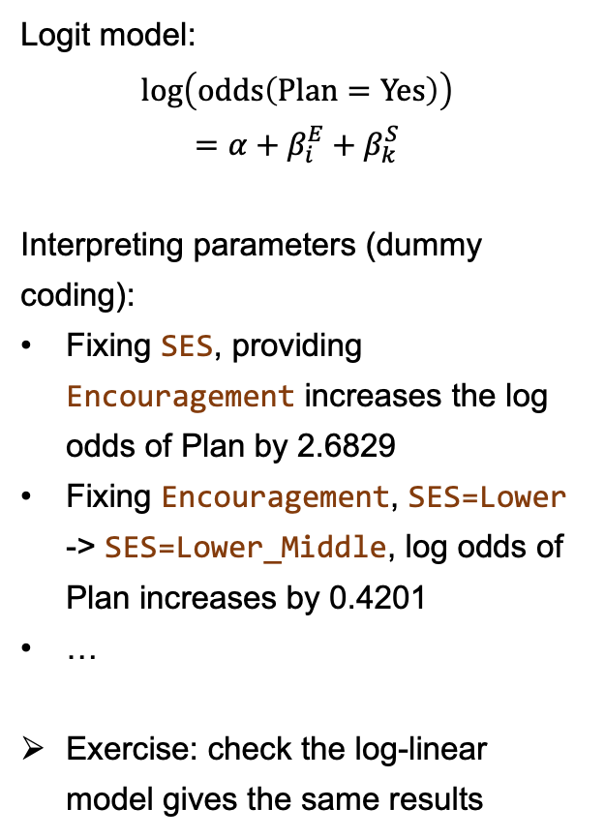
Log-linear – Logit connection — Example of Wisconsin
Logit model:
$$log\left(odds\left(Plan=Yes\right)\right)$$
$$=α+β_{i}^{E}+β_{k}^{S}$$
Interpreting parameters (dummy coding):
Fixing SES, providing Encouragement increases the log odds of Plan by 2.6829
Fixing Encouragement, SES=Lower -> SES=Lower_Middle, log odds of Plan increases by 0.4201
…
Exercise: check the log-linear model gives the same results
S
E
P
log-linear model of homogeneous association
S
E
P
Equivalent logit model

Slide 13
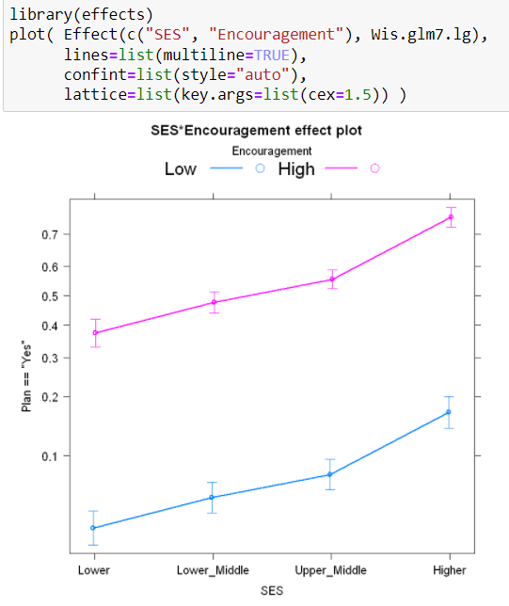
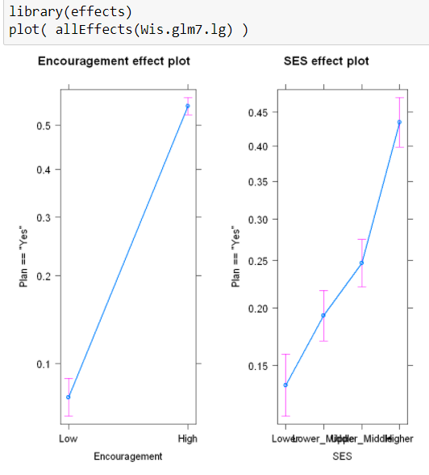
Log-linear – Logit connection — Example of Wisconsin
Effect plots from library(effects)
Parallel lines (in log odds scale):
No interaction between SES and Encouragement

Slide 14
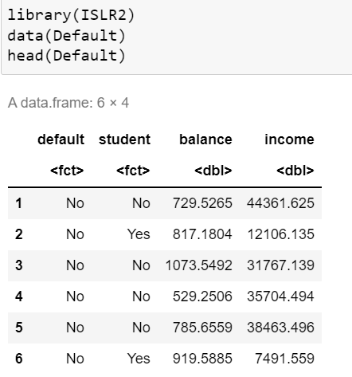

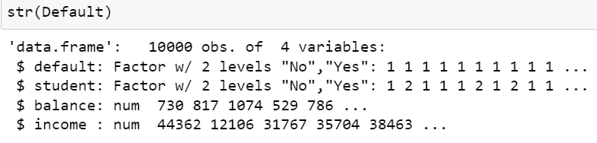
Example — Credit Card Default (违约)

Slide 15

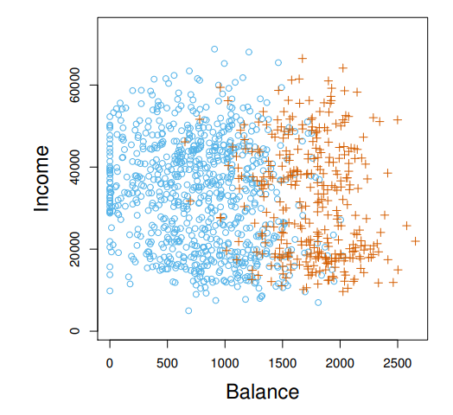
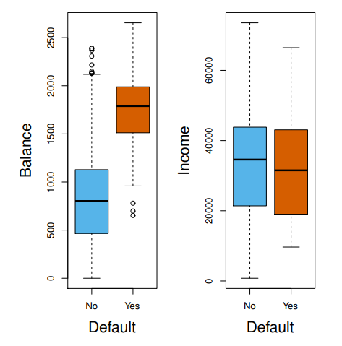
Example — Credit Card Default — Continuous Explanatory
Blue: non-default
Orange: default
Individuals who defaulted tended to have higher credit card balances than those who did not.
The association between income and default is weak.

Slide 16
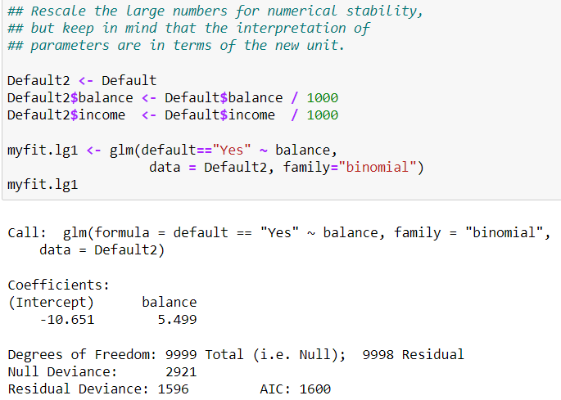
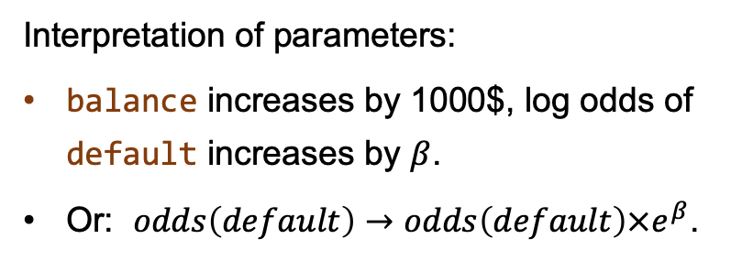
Example — Credit Card Default — Continuous Explanatory
1st model (myfit.lg1): $logit\left[P(default=Yes)\right]=α+β×blance$
More progressively, you can rescale the explanatory to have zero mean and unit variance.
Keep this in mind when you need to interpret the parameters.
Interpretation of parameters:
balance increases by 1000$, log odds of default increases by $β$.
Or: $odds\left(default\right)→odds\left(default\right)×e^{β}$.

Slide 17
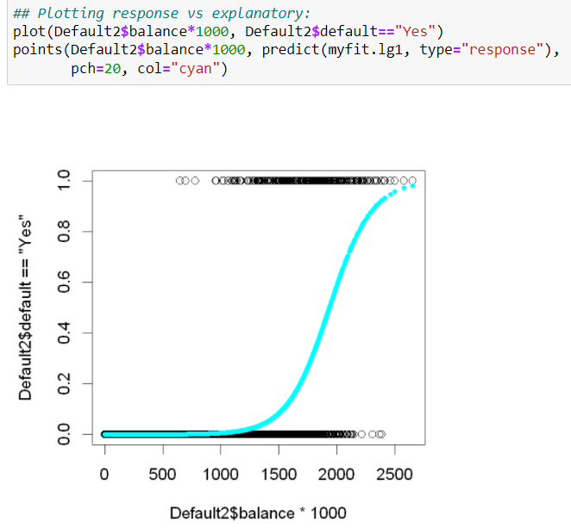
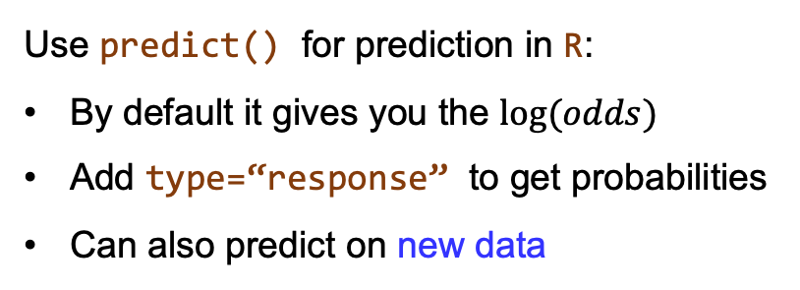
Example — Credit Card Default — Continuous Explanatory
Use predict() for prediction in R:
By default it gives you the $log⁡(odds)$
Add type=“response” to get probabilities
Can also predict on new data

Slide 18
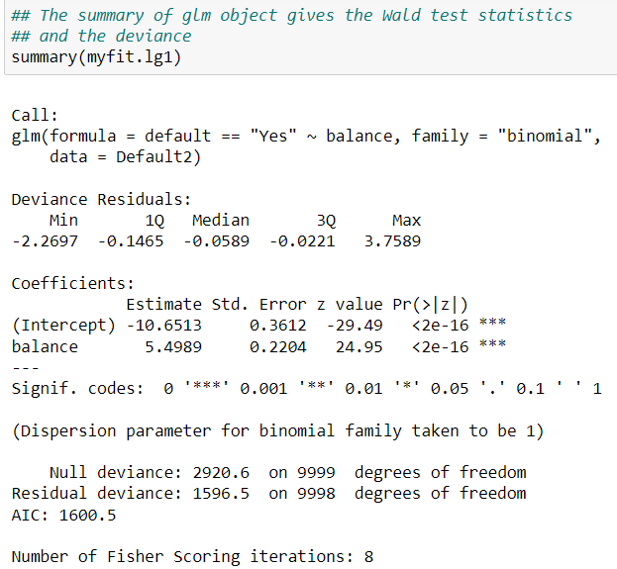
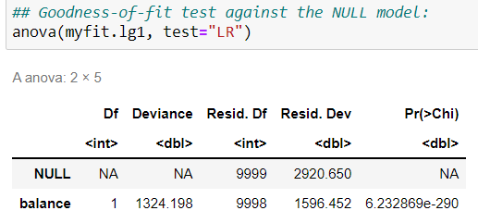
Example — Credit Card Default — Continuous Explanatory
LR test shows that the proposed model (myfit.lg1) fits better than the NULL model (intercept-only model).
Wald test shows that the coefficient of balance is very significant.

Slide 19
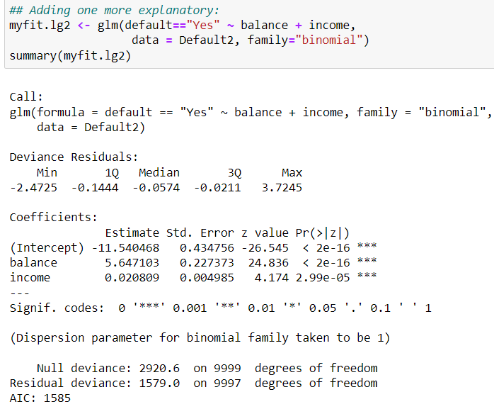
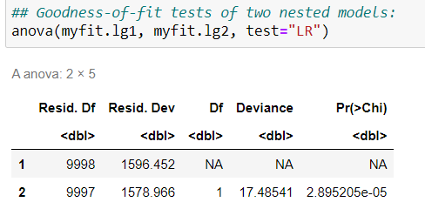
Example — Credit Card Default — Continuous Explanatory
myfig.lg2: adding income as an explanatory
The effect of income is weak (small magnitude), but statistically significant.
Adding income brings only a small improvement in fitting, as expected.

Slide 20
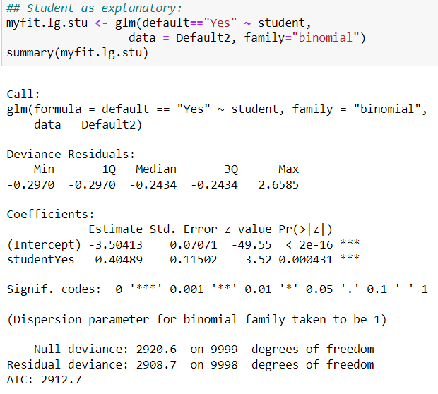




Example — Credit Card Default — Categorical Explanatory
myfit.lg.stu: student as the only explanatory:
Remind that glm() use a dummy coding, with a value of 1 for a student and a value of 0 for a non-student.
“Student=Yes” increase the odds of default.
This effect is significant.

Slide 21

投票
最多可选1项
Based on the data, do you think whether a credit card company should offer less credit to students?
A
Yes
B
No
C
Not enough evidence
提交

Slide 22
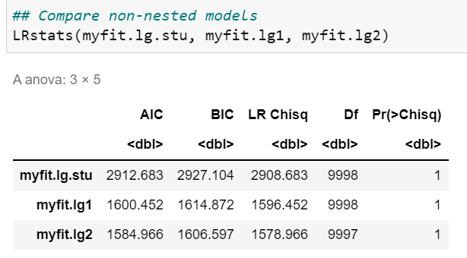
Example — Credit Card Default — A remark on model comparison
Remind:
myfit.lg.stu => default=="Yes" ~ student
myfit.lg1 => default=="Yes" ~ balance
myfit.lg2 => default=="Yes" ~ balance + income
myfit.lg.stu is neither nested within myfit.lg1 nor myfit.lg2
So we CANNOT apply LR/chi-squared test to compare myfit.lg.stu against the other two.
But we can compare their overall fit measures, as well as the AIC and BIC.

Slide 23
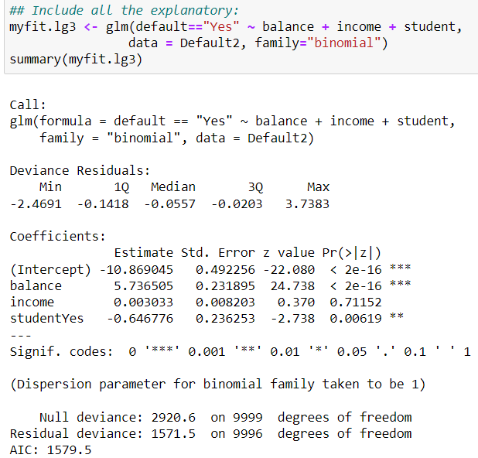

Example — Credit Card Default — Include them all
myfig.lg3: include all the available explanatory variables in the data set:
Observations
income is significant in myfit.lg2; but including student makes it non-significant…
“student=Yes” has a positive effect on log odds of default in myfit.lg.stu; but it has a negative effect here…

Slide 24
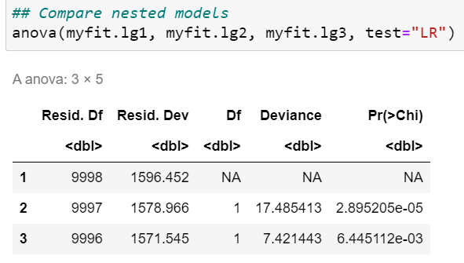
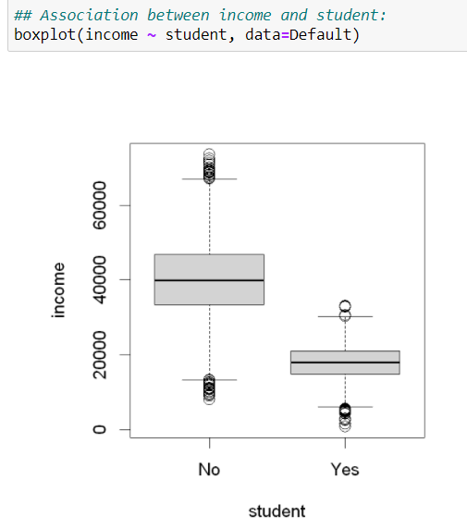
Example — Credit Card Default — income and student
Including income helps to fit the data, as myfit.lg2 improves over myfit.lg1.
What happens is that, income has a rather strong association with student.
In myfit.lg3, the information of income and student appear to be redundant.
Association between student and income.
We can roughly use income to infer the status of student.

Slide 25
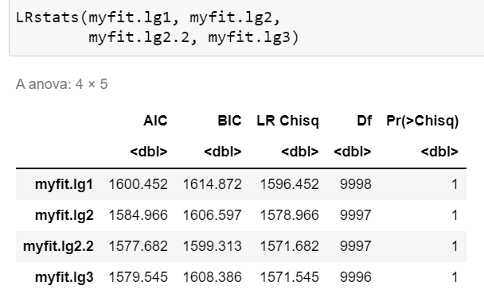

Example — Credit Card Default — Dropping income
Myfit.lg2.2: drop the income variable from the full model:
“student=Yes” also has a negative coefficient, after removing the redundant income information.
myfit.lg2.2 is better than myfit.lg2, and comparable to myfit.lg3 in various measures!

Slide 26

Example — Credit Card Default — Dropping income
Remind:
myfit.lg2.2 => default=="Yes" ~ balance + student
myfit.lg3 => default=="Yes" ~ balance + income + student
Since myfit.lg2.2 is nested within myfit.lg3, we can perform a LR/chi-squared test to compare them
No good evidence to include income when balance and student are used.
Notes:
What do you think ?

Slide 27



Example — Credit Card Default — Effects of student
Remind:
myfit.lg.stu => default=="Yes" ~ student
myfit.lg2.2 => default=="Yes" ~ balance + student
Let’s take a closer look at the student-balance-default relation:
Blue: non-student
Orange: student
Observations:
Conditioned on the level of balance, students always has lower default rate than non-students (less risky) !
Yet, students have a higher overall default rate.
This is because students tend to have a higher balance (strongly correlated with default).
Simpson’s paradox.
Dangerous to consider only the overall effect (or miss an important explanatory)

Slide 28


Example — Credit Card Default – Effect plots
Effect plots for
myfit.lg2.2 => default=="Yes" ~ balance + student
myfit.lg3 => default=="Yes" ~ balance + income + student

Slide 29


Example — Credit Card Default — Classification
How does the logit model function as a classifier ?
Note that we did not create a test data set at the beginning, which we should have done if we care more about making prediction.
Nevertheless, let's examine the training model here.
Apply the conventional (deterministic) decision making: $if π\left(x_{i}\right)>0.5, predict y_{i}=1$.
Good or bad (as a training accuracy) ?
Notes:
In principle, the model is probabilistic, given a pi_i, yi = 0 or 1 can happen.

Slide 30



Example — Credit Card Default — Classification
What does it imply ?
Consider the naïve classifier:
P(default = No) = 1
Not a bad number!
(in terms of accuracy).

Slide 31


Evaluating a Classifier
true positive rate (TPR), sensitivity, recall
$$TPR=\frac{TP}{P}=\frac{TP}{TP+FN}$$
false positive rate (FPR)
$$FPR=\frac{FP}{N}=\frac{FP}{TN+FP}$$
true negative rate (TNR), specificity
$$TNR=\frac{TN}{N}=\frac{TN}{TN+FP}$$
positive predictive value (PPV), precision
$$PPV=\frac{TP}{TP+FP}$$
Confusion matrix for binary classifier:
Although the classification accuracy is commonly used, it is in general NOT enough to use a single number to evaluate a classifier. Two common combinations:
true positive rate (TPR) + false positive rate (FPR)
precision + recall

Slide 32





Example — Credit Card Default — Classification
Confusion matrix for binary classifier:
true positive rate (TPR), sensitivity, recall
$$TPR=\frac{TP}{P}=\frac{TP}{TP+FN}$$
Among all the real defaults, how many are correctly identified.
$$TPR=\frac{105}{105+228}=31.5\%$$
Do you consider it good or bad?
(Think about random guess.)
$$TPR=0\%$$

Slide 33




Example — Credit Card Default — ROC curve
$$TPR=\frac{TP}{TP+FN}$$
$$FPR=\frac{FP}{TN+FP}$$
Using different cutoffs/thresholds, the classifier gives different TPR and FPR
This gives the ROC Curve, a summary of the predictive power of the classifier.
Further summarized by area under the curve (AUC)
But too optimistic for imbalanced data.
Notes:
Most common cutoff: 0.5.
Low threshold: more positives
More true positive -> higher TPR
(2) More false positive -> higher FPR
Ideal classifier: top-left corner (point (0, 1))
Random guess at all thresholds: ROC is a diagonal line.
AUC = 0.95 is quite good in general (Random guess AUC=0.5). But here we have imbalanced data.

Slide 34



Example — Credit Card Default — Precision-recall curve
For imbalanced data like the Default data
ROC curves can present an overly optimistic view of an algorithm's performance.
The precision-recall curve is a better alternative.
$Recall=TPR=\frac{TP}{P}=\frac{TP}{TP+FN}$
Among all the real positives, how many are correctly identified.
$Precision=PPV=\frac{TP}{TP+FP}$
Among all the predicted positives, how many are true.
One can summarize a precision-recall curve by
area under the curve (AUC)
Break-even point (BEP)
Other measure for imbalanced data:
F-beta score (F1 score is commonly used)
Notes:
PR curve: top-right corner (point (1, 1)) is the ideal.
Random guess at a threshold: a horizontal line.
The precision recall break-even point is the point at which the precision-recall-curve intersects the bisecting line.

